Slide 1
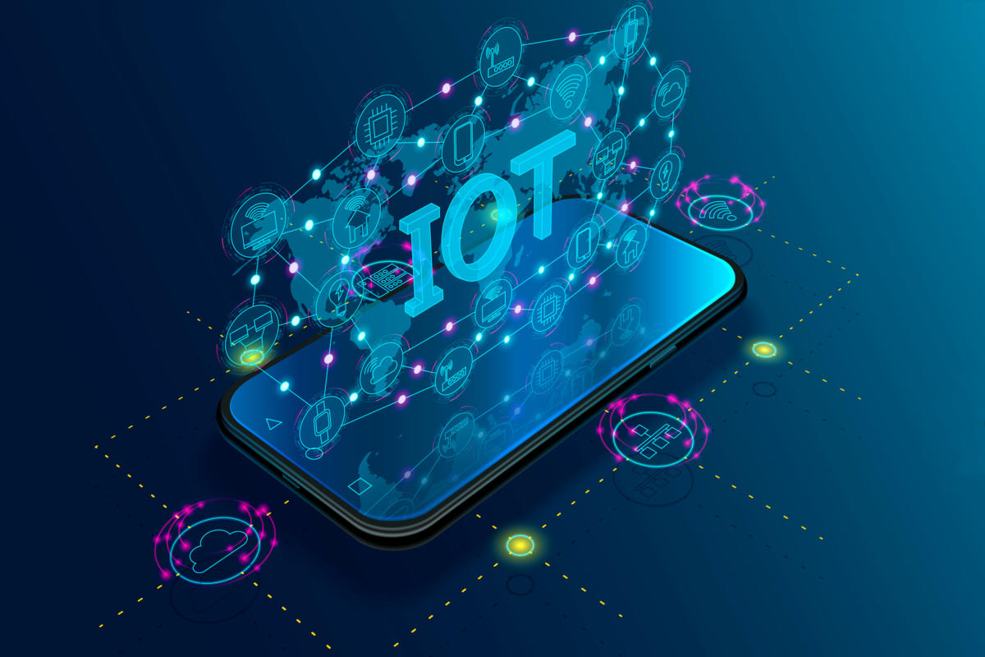
Smart Lock IoT System
An Enterprise-Grade Hybrid Architecture
Name
Index
Suriyabandara S.M.M.
Ravimindu P.H.G.
Keembiyage J.S.
210626L
220530V
220319H

Slide 2
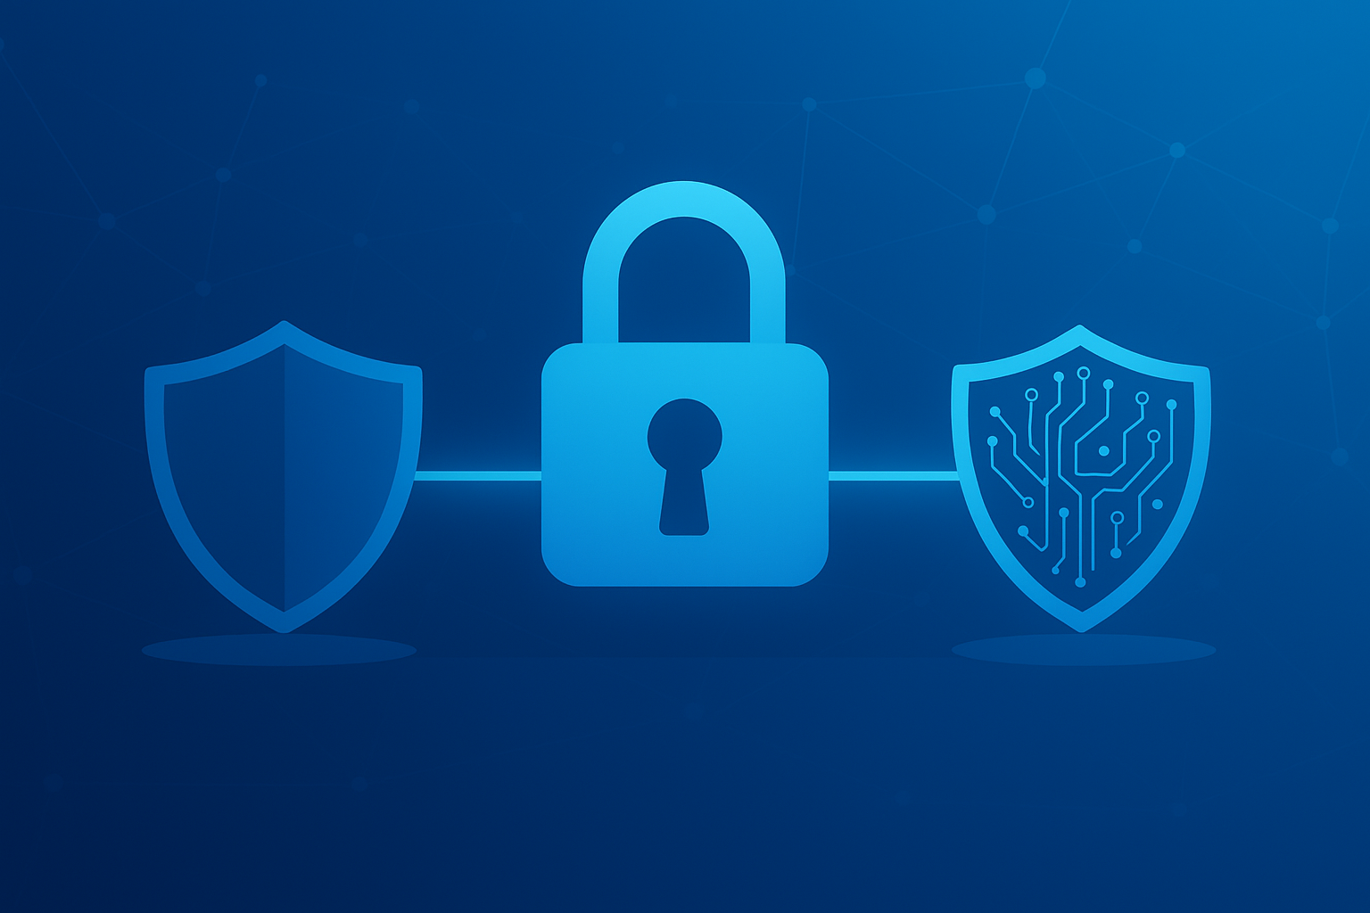
The Challenge: Bridging Physical and Digital Security
🔐
The Problem
🚀
Our Solution
Physical keys have no digital logs or audit trail.
Keypad-based authentication with digital event logging.
Keys are easily lost, duplicated, or stolen.
Real-time tamper detection via vibration sensors.
No remote access or real-time monitoring capabilities.
Cloud-hosted dashboard for remote monitoring and control.
No immediate alerts for unauthorized access attempts.
Enterprise-grade security with Azure IoT Hub integration.

Slide 3
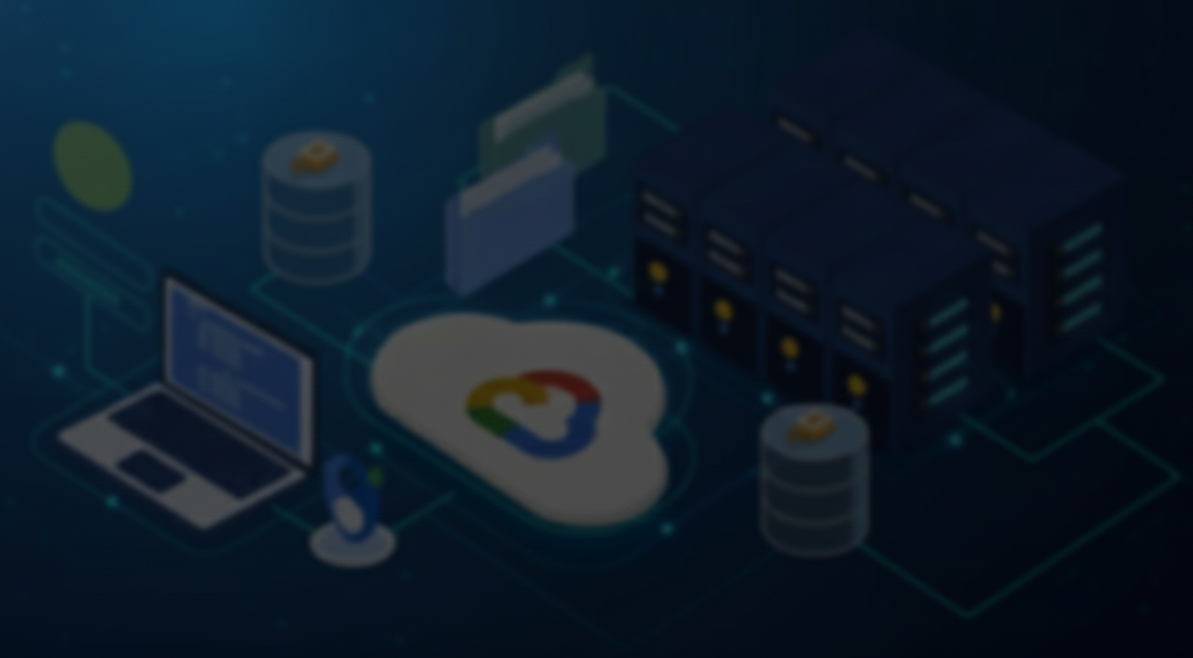
Core Objectives: Building a Secure and Scalable IoT Solution
1
2
Secure Hardware Prototype
Real-Time Web Dashboard
Develop a reliable smart lock system using Arduino UNO and Raspberry Pi with real-time control and safety mechanisms.
Implement a cloud-hosted Node-RED dashboard for live monitoring, activity logging, and remote lock/unlock control.
Project Scope
This project demonstrates a complete IoT solution spanning hardware control, edge computing, cloud integration, and secure data management. It validates enterprise-grade architectural patterns for IoT systems.
3
4
Proactive Alerting
Full-Stack Integration
Integrate tamper detection via vibration sensors and failed authentication alerts with instant notifications.
Demonstrate seamless integration of edge devices, cloud services (Azure IoT Hub), and data persistence (Table Storage).

Slide 4

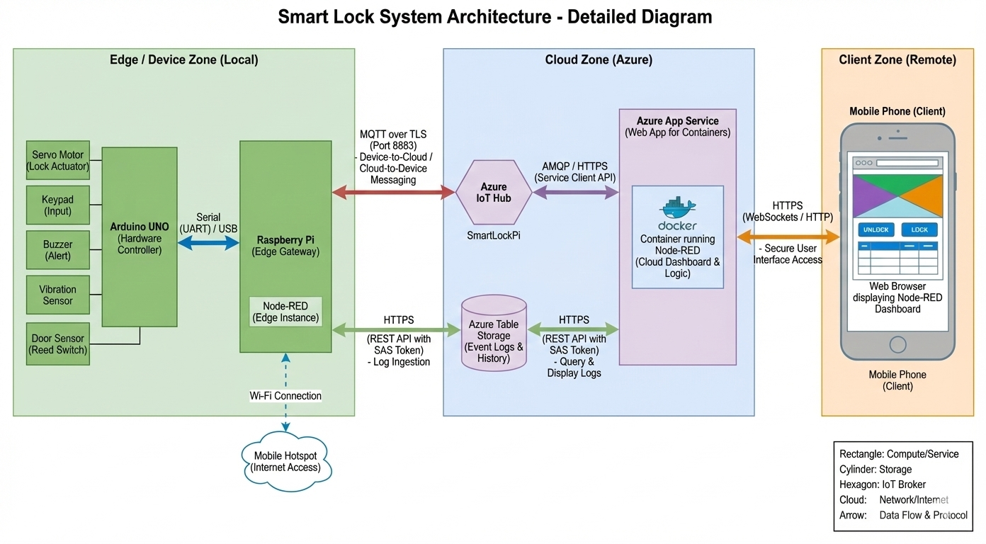
3-Layer Architecture
🔒 Safe Edge Gateway Pattern
RPi isolates the Arduino from direct internet access, handling TLS and MQTT. The Arduino stays focused on real-time hardware control, keeping lock logic protected even if cloud connectivity is lost.

Slide 5
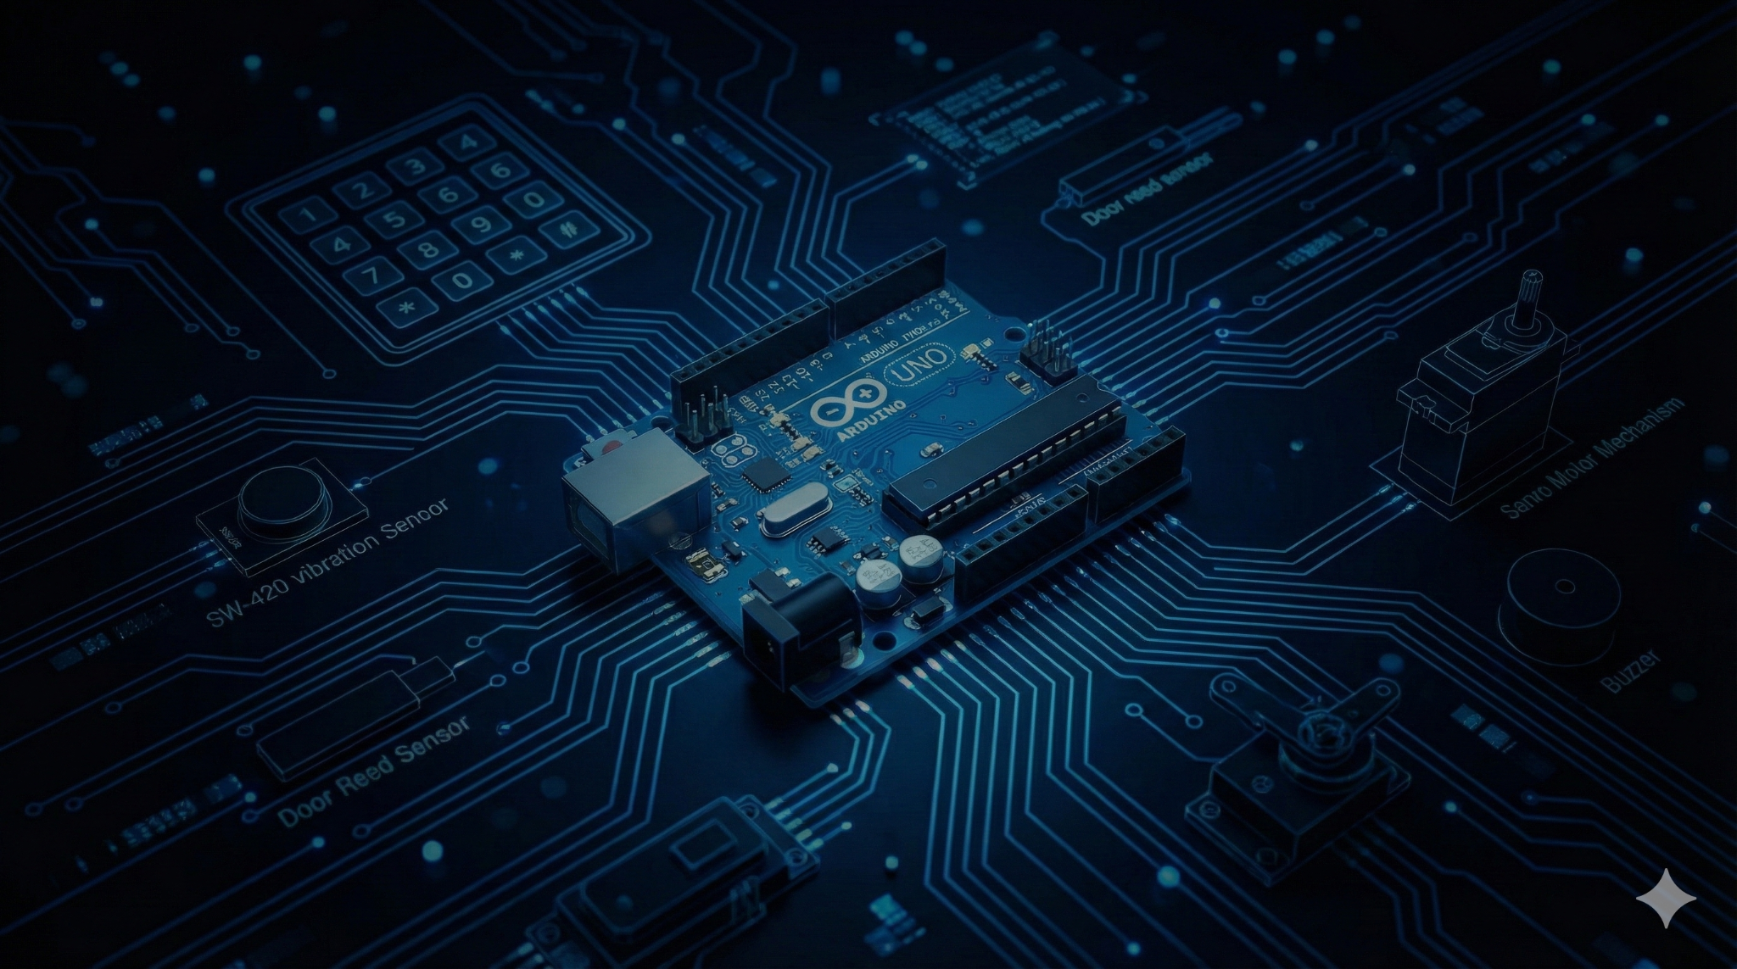
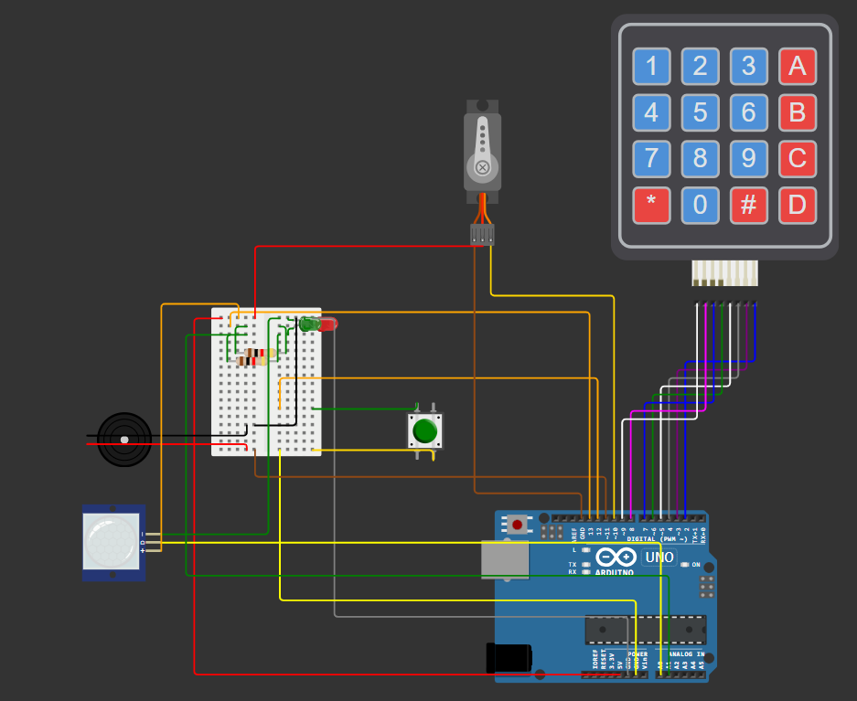
Layer 1: Device Zone - The Physical Edge (Circuit)
Controller
Arduino UNO
Hardware Components
Keypad (4x4)
Vibration Sensor (SW-420)
Push Button as the Door Sensor
Servo Motor
Buzzer
IoT Principle: Constrained Device
The Arduino cannot handle heavy TLS or MQTT; the RPi gateway manages network complexity while the Arduino focuses on deterministic hardware control.

Slide 6
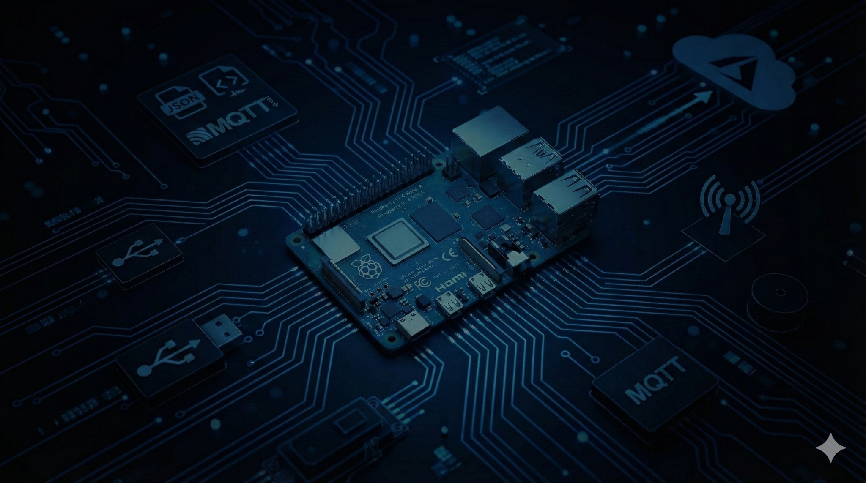
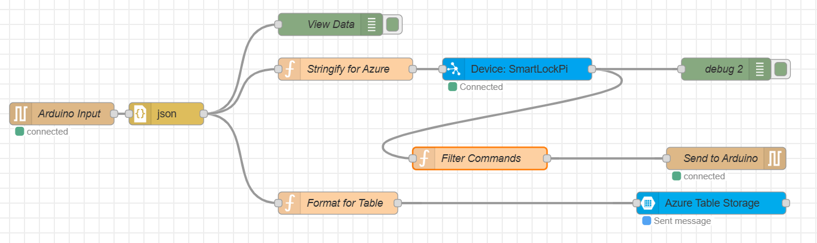
Layer 1: Device Zone - The Protocol Converter (RPi Logic)
Primary Role
Protocol Converter & Edge Gateway
The Raspberry Pi bridges the gap between the constrained Arduino device and the cloud, handling protocol conversions and security operations.
Input
Processing
Serial Data (JSON) /dev/ttyACM0 From Arduino UNO
Output
Hot Path: Convert data to MQTT format
Cold Path: Formats data for REST API insertion into the table storage
↓
↓
To Cloud: MQTT over TLS(Port 8883) -> Azure IoT Hub
To Table Storage: HTTPS REST API -> Azure Table Storage

Slide 7
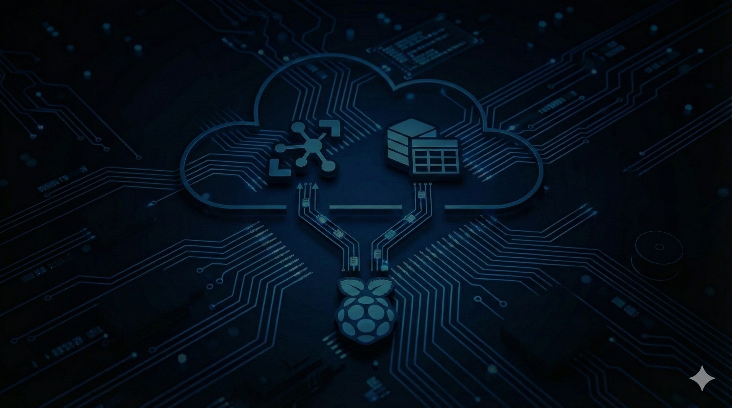
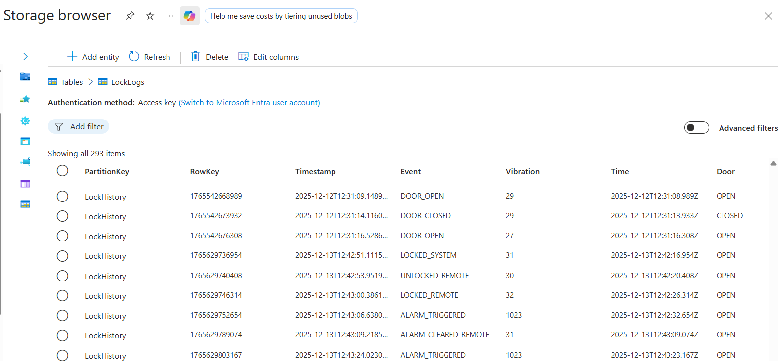
Layer 2: Cloud Zone - Azure IoT Hub & Azure Table Storage
Azure IoT Hub: The Secure Broker
Role: Acts as the central message broker for secure, bi-directional communication between the Edge Gateway and the Cloud.
Device Identity: Manages a Device Identity Registry to ensure only authorized devices (like SmartLockPi) can connect, preventing spoofing attacks.
Function: Handles MQTT Telemetry for "Hot Path" connectivity and Cloud-to-Device (C2D) messages for remote control commands.
Azure Table Storage: The Data Warehouse
Role: Provides cost-effective, persistent storage for historical event logs.
Why NoSQL?: Optimized for storing massive amounts of unstructured time-series data (Timestamp, Event, Value) without the overhead of complex SQL relationships.
Security: Accessed via SAS Tokens (Shared Access Signatures), enforcing the "Principle of Least Privilege" by granting only necessary permissions.

Slide 8
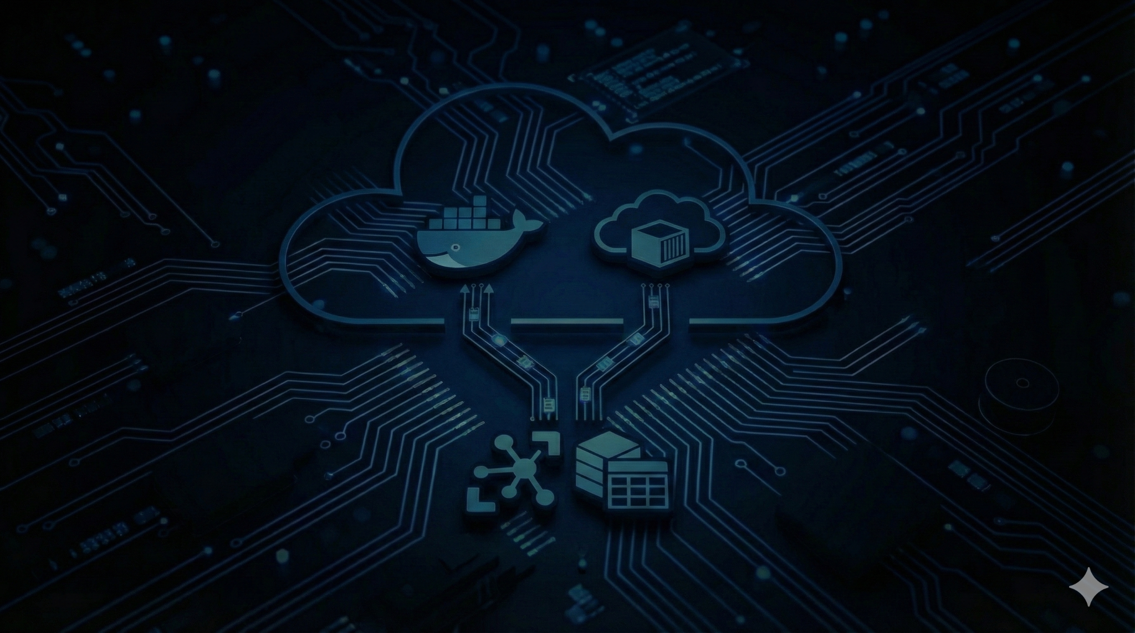
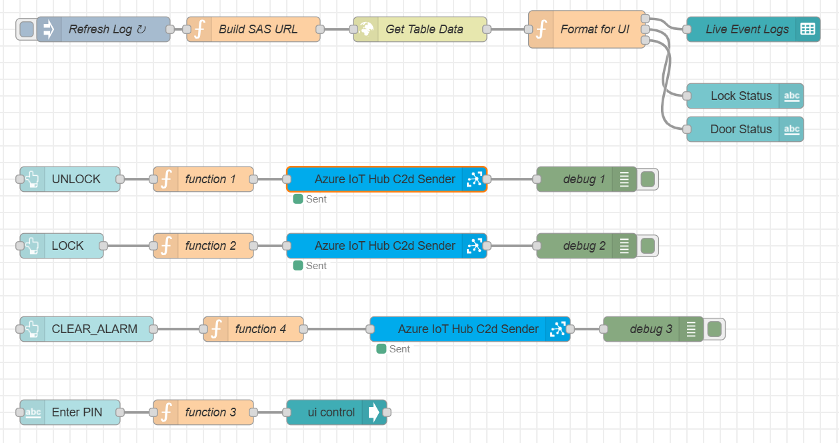
Layer 2: Cloud Zone - Azure App Service
Deployment Architecture
Node-RED application logic runs inside a Docker container deployed on Azure App Service, enabling portability, scalability, and high availability.

Slide 9
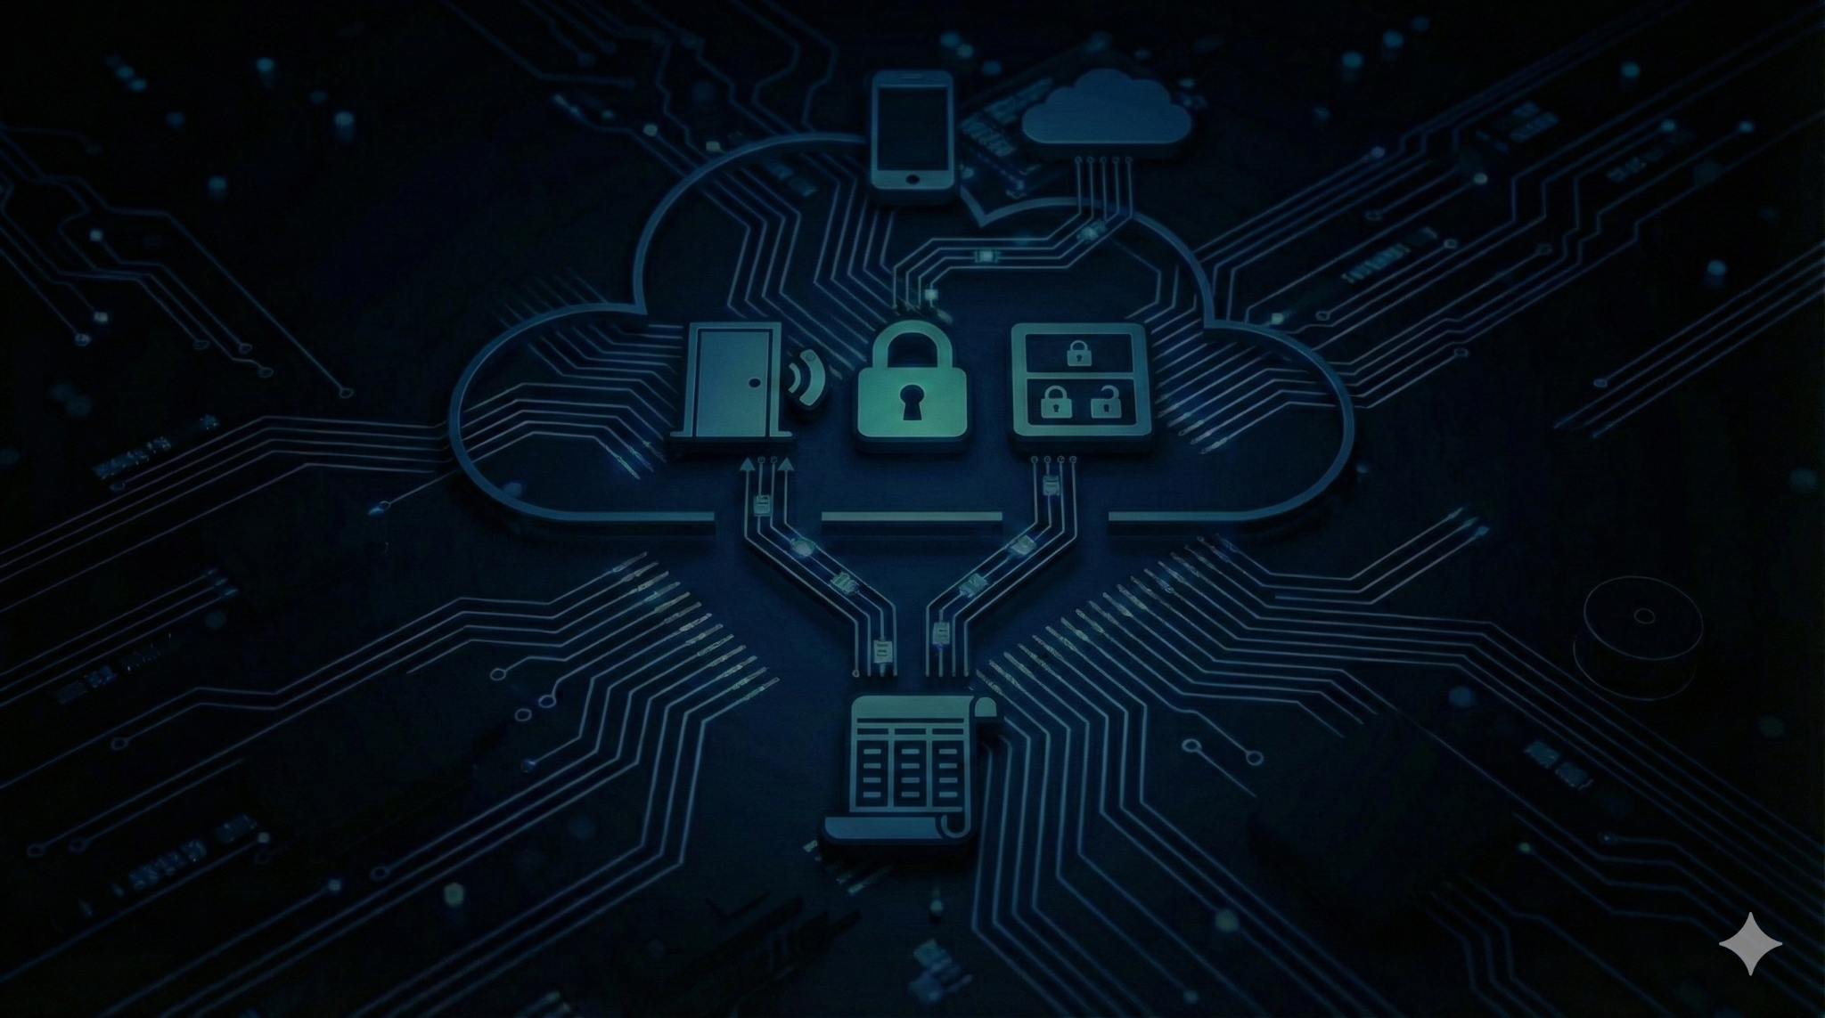
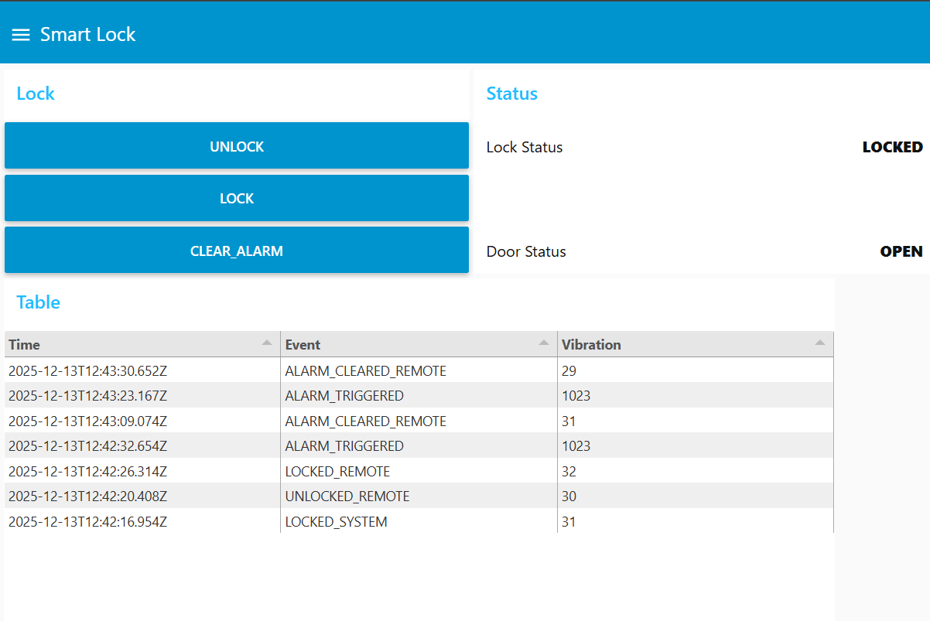
User Interface: Real-Time Monitoring and Remote Control
Dashboard Components
Lock Status Indicator
Real-time display of lock state (Locked/Unlocked) with color-coded visual feedback.
Door State Monitor
Live status of door open/closed state from magnetic sensor telemetry.
Remote Control Panel
Interactive buttons to send lock/unlock commands directly to the device via cloud.
Activity Log Table
Historical record of all lock events: authentication attempts, door open/close, tamper alerts.
Node-RED Dashboard: Real-Time Lock Control Interface

Slide 10

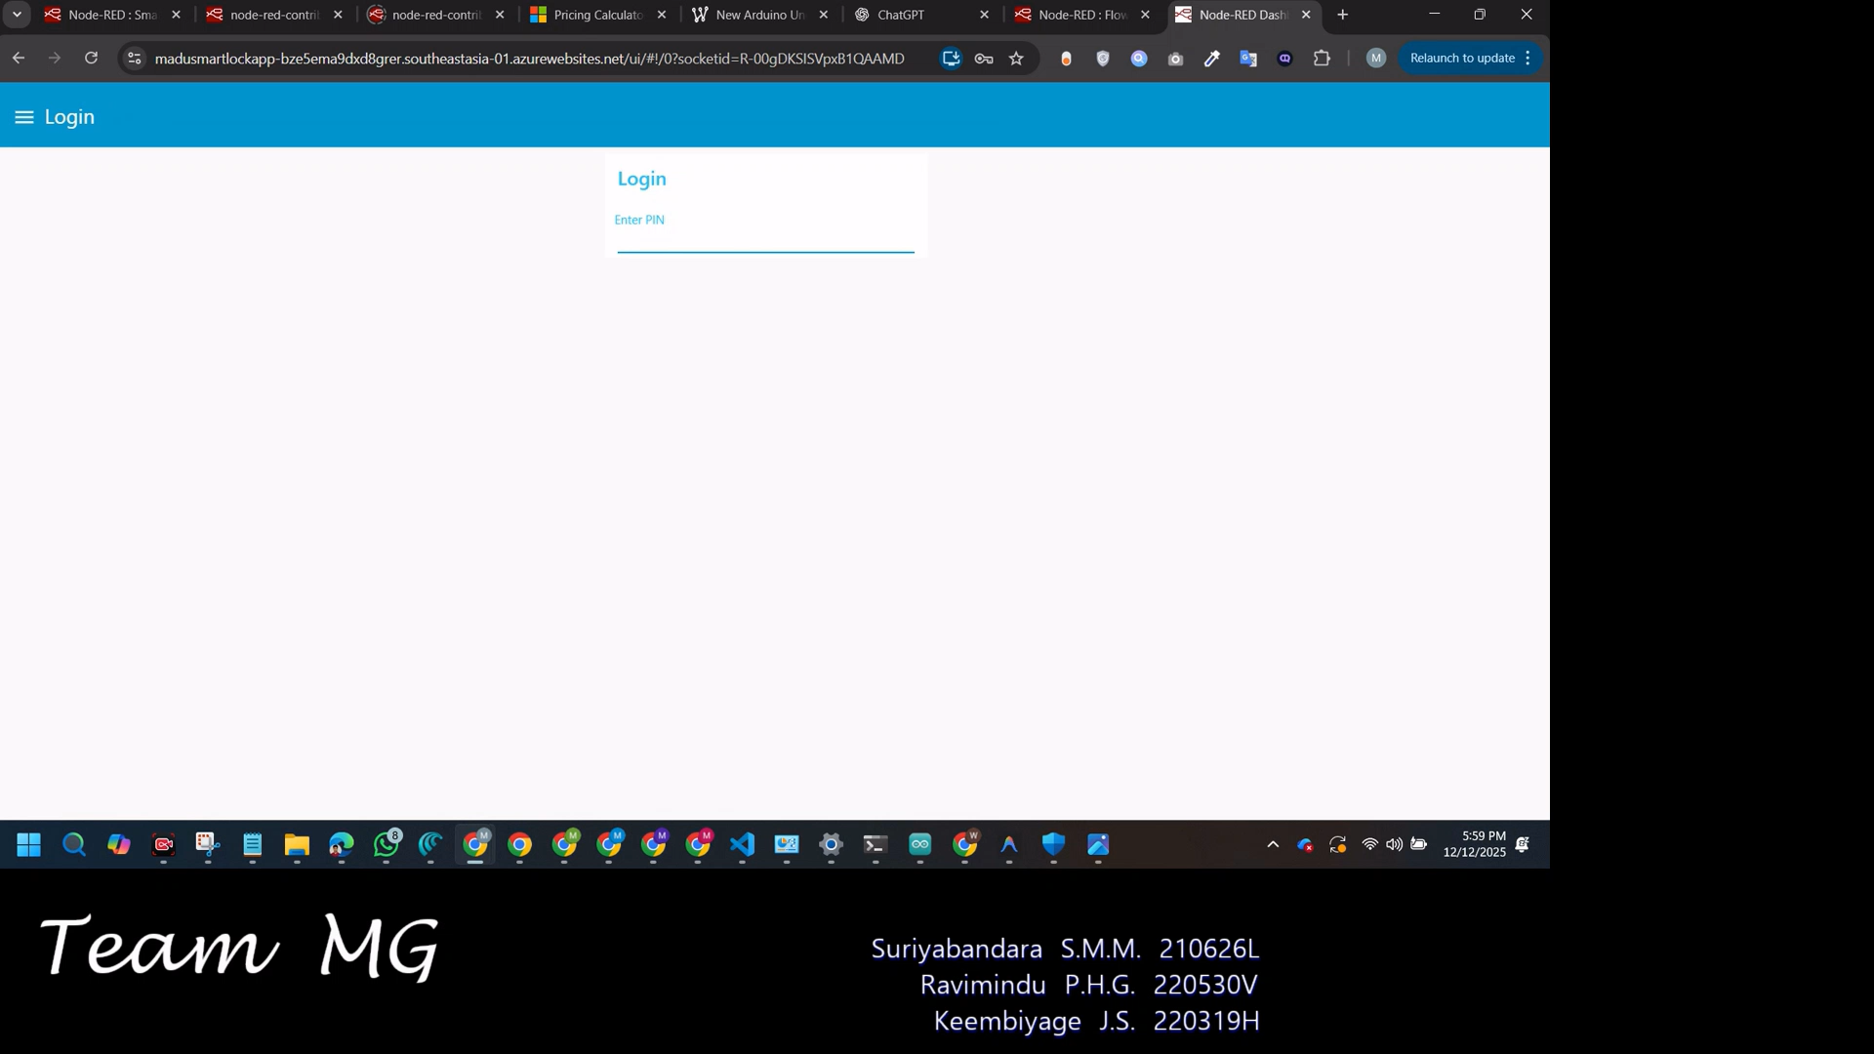
🔴 DEMO VIDEO
💡 Key Insight: All actions are logged in Azure Table Storage and visible in the real-time dashboard, demonstrating full-stack IoT integration.

Slide 11
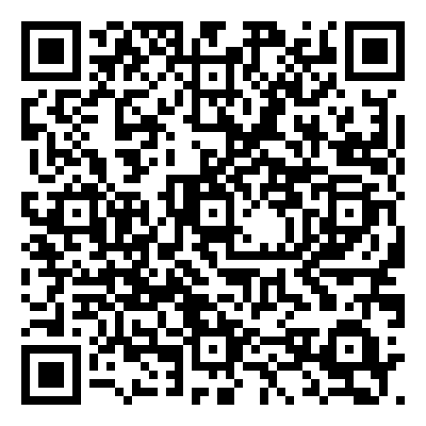

Scan The QR - Access the Dashboard
Password: 1234

Slide 12
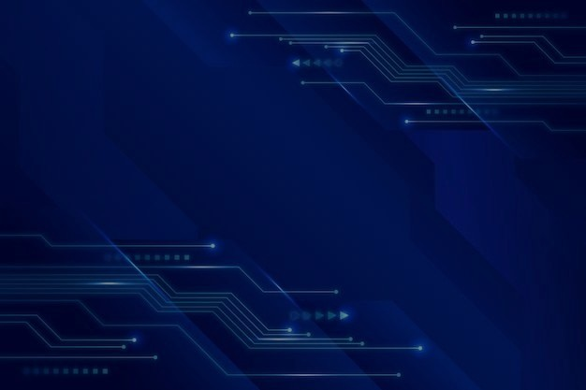
The Backwards Flow
1. Web Browser
HTTPS / WebSocket
2. Azure App Service
Node-RED Dashboard Logic
3. Azure IoT Hub
C2D Message (Cloud-to-Device)
4. Raspberry Pi Gateway
MQTT Subscription (TLS Port 8883)
5. Arduino UNO
Serial UART / USB (/dev/ttyACM0)
6. Servo Motor
PWM Control Signal

Slide 13
Security Architecture: Three Pillars of Protection
1
2
3
Device Identity
Access Control
Physical Security
Each RPi has a unique identity registered in Azure IoT Hub's Identity Registry.
SAS Tokens enforce Principle of Least Privilege for database access.
Arduino is air-gapped from the internet, isolated by the RPi gateway.
Prevents spoofing attacks by validating device credentials.
Time-limited tokens that expire automatically.
Cannot be hacked directly from the web.
Each token grants only necessary permissions (read/write logs).
All network communication goes through RPi.
Only authenticated devices can publish telemetry.
Lock logic remains functional even if cloud is compromised.
Prevents privilege escalation and lateral movement.
🔐 Overall Security Posture
This system uses multiple levels of protection, called defense-in-depth, to keep the lock secure. First, it confirms the identity of the device trying to access it, and then it only grants a temporary, time-limited digital key. Crucially, the physical lock mechanism, run by an Arduino, is physically isolated ("air-gapped"). This means that even if the network or cloud security is breached, the lock remains functional and protected because its core mechanism is disconnected from those digital systems.

Slide 14
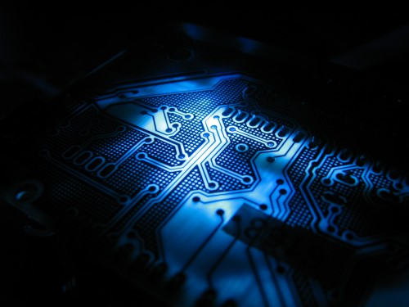
Performance Metrics and System Constraints
Local Latency
Cloud Latency
< 500ms
< 2s
Keypad entry to servo actuation. Real-time response with zero network dependency.
Dashboard button press to servo actuation via Azure IoT Hub and MQTT.
System Constraints & Reliability
Constrained Device Architecture
Arduino UNO lacks computational resources for TLS encryption and MQTT protocol. RPi Gateway is mandatory for secure cloud communication.
Network Resilience
Local lock control operates independently. If cloud connectivity is lost, the system defaults to local keypad-only mode with full functionality.
Connected Status Monitoring
Node-RED continuously monitors RPi-to-IoT Hub connection state. Dashboard displays real-time connectivity status to users.

Slide 15
Implementation Deviations and Justification
`
Database Migration
Reason
Implemented Azure Table Storage instead of MariaDB as originally proposed.
Cost-Effectiveness for Time-Series Data. Azure Table Storage is a NoSQL structure optimized for fast writes and simple log data (Timestamp, Event, Value) without complex JOINs, significantly cheaper than a traditional SQL database like MariaDB for massive event history.
`
Cloud Broker Integration
Reason
Integrated Azure IoT Hub instead of a simple, self-hosted MQTT broker.
Enterprise-Grade Device Management & Security. IoT Hub provides an Identity Registry to prevent spoofing attacks and is built for scalability, demonstrating a more robust and secure architecture than a simple, self-hosted MQTT broker.
`
Database Migration
Reason
Implemented Azure Table Storage instead of MariaDB as originally proposed.
High Availability & Decoupling. Hosting the dashboard in the cloud ensures accessibility from anywhere and decouples the UI from the physical device. If the RPi loses power, the dashboard remains available with the last known status.

Slide 16
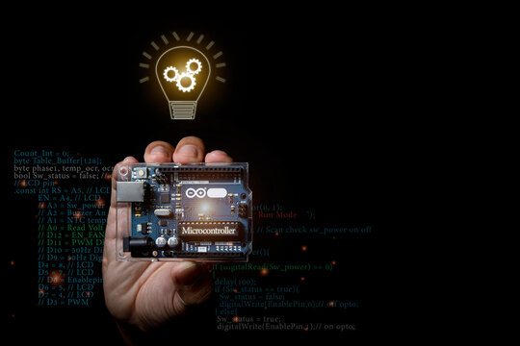
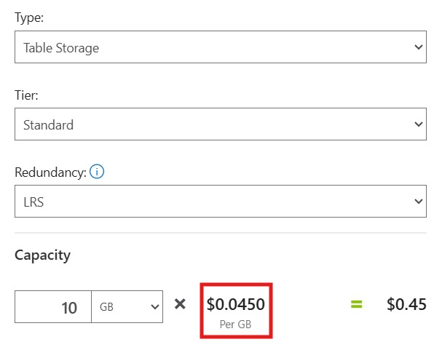
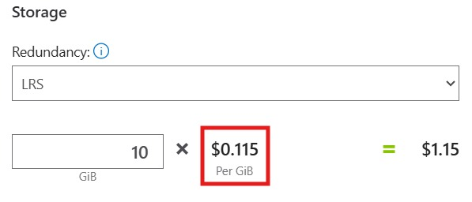
Data Persistence - Cost-Effective NoSQL for Telemetry
Nature of Data
Original Proposal
Our data is simple time-series telemetry: Timestamp, Event Type, Value. This is unstructured log data that rarely requires complex relational JOINs or transactions.
MariaDB (SQL)
↓
Cost-Effectiveness
NoSQL is significantly cheaper for massive event history storage.
Actual Implementation
Pay-per-transaction pricing vs. per-instance SQL Database costs.
Azure Table Storage (NoSQL)
Scales horizontally without expensive database upgrades.
Performance Benefits
Optimized for fast writes and key-based retrieval.
No schema migration overhead for evolving telemetry formats.
MariaDB (SQL)
Azure Table Storage (NoSQL)

Slide 17
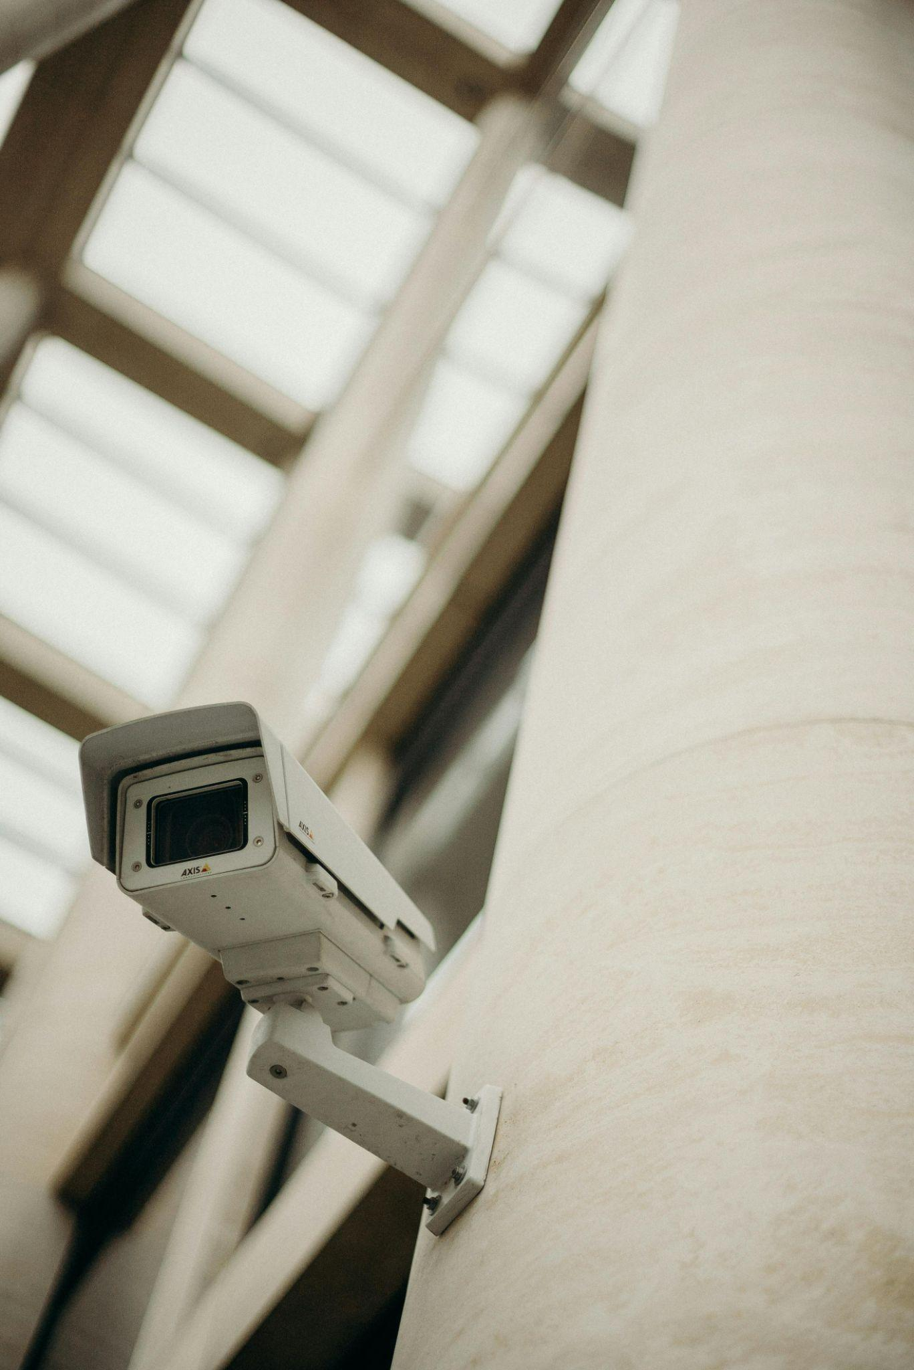
Future Development
Event-Driven Recording: A CCTV camera will be strategically positioned to cover the door,
only initiating power and recording upon the detection of a significant door vibration event.
How it Works ?
The camera will be offline until the vibration sensor detects any kind of a vibration and if a
vibration occurred the cctv will automatically powered and it also sends a video clip of pre-defined
time period to the database.
Benefits
Power Efficiency
Storage & Cost Management

Slide 18
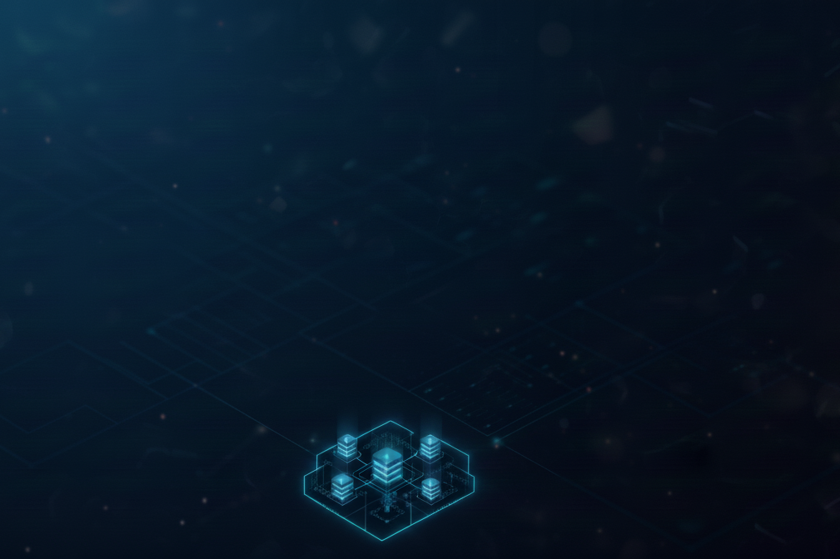
Reasons for Some Architectural Decisions
Why not ESP 32?
If connection loses , the lock is locked/ feezed while trying to reconnect.
Why not ESP 32 instead of RPi?
Handling cloud connection & managing complex certificates and SAS tokens is
computationally heavy.
Why MQTT between RPi & IoT hub?
Lightweight & low power usage &data overhead is less.
Why QoS 01?
To ensure that commands & alerts are guaranteed to be delivered.
Azure IoT hub does not standardly support QoS 2.
Why cold path for UI?
User experience.
If we used the hot path , it may show two different things in the table & the status Section.

Slide 19


